Slide 1

IP-What Every Lawyer & Every Client Must Understand
Allan Grafman
Sanjay Prasad
Barine Majewska
Intellectual Property 101

Slide 5
3/10/26

Slide 6
Allan Grafman - All Media Ventures
Sanjay Prasad - Appleton Luff
Barine Majewska - Vicente LLP

Slide 7
IP-What Every Lawyer & Every Client Must Understand
Intellectual property or “IP” is a term used to describe certain types of intangible property.
  Like other forms of property, such as real estate & personal property, IP can be owned, purchased, licensed, & transferred.
  How ownership is determined differs according to the type of IP.
This webinar discusses the importance of certainty in ownership of IP and how ownership of IP is entangled with areas of corporate law & employment law.

Slide 8
Intellectual Property 101
Intellectual property (IP) rights constitute an important asset class. Indeed, both startups & mature companies alike now invest heavily in IP to protect their assets & innovation.
There are different IP vehicles to protect innovation. These include patents, trademarks, copyrights, & trade secrets that work together to protect different aspects of IP. This webinar series will explore:
How to create rights in one of these assets?
How to protect IP rights?
How you transfer them (or have them transferred to you)?
How they interact with each other?
This information-packed webinar series focuses on the intricacies of IP rights as they relate to the specific areas of brand protection, IP transactions, internet marketing, and other IP issues that are critical when representing innovators and inventors. This webinar series will also touch on cutting edge technologies, including artificial intelligence (AI) and generative AI.

Slide 9
IP-What Every Lawyer & Every Client Must Understand
Premiere date: 3/10/26
Copyrights, Patents, and Trademarks...Oh My!
Premiere date: 4/07/26
Leveraging & Protecting Trade Secrets in the 21st Century
Premiere date: 5/12/26

Slide 10
Episode #1
IP - What Every Lawyer &
Every Client Must Understand

Slide 11
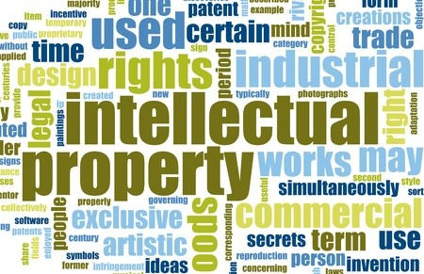
Presentation Overview
What is intellectual property (IP)?
Basic IP Rights:
    Copyrights
    Trademarks
    Patents
    Trade Secrets
How do you protect your IP & avoid infringement?

Slide 12
Types of Property
Under the law, property is generally categorized as:
Real property – buildings & land.
Personal property – all other property, including:
  Tangible property (e.g., office equipment & furniture) and
  Intangible property (e.g., stocks, bonds, & intellectual property).

Slide 13
What is Intellectual Property?
Intellectual property (IP) refers to intangible creations of the mind.
There are four main types of IP:
Copyrights – protect works of authorship, such as books, music, or pictures.
Trademarks – protect company identifiers, such as logos or package designs.
Patents – protect new & useful inventions, discoveries, etc.
Trade Secrets – protect commercially valuable protected information such as business plans, formulas, or customer information.

Slide 14

Why is Intellectual Property Important?
Intellectual property can be a company’s greatest asset.
For example, intellectual property:
Builds brand loyalty & awareness;
May be sold, licensed, or leveraged for profit; and
Protects interests in inventions, technology, goods & services used and sold by companies.

Slide 15

What is a Patent?
A patent is a right granted by the U.S. government to an inventor for a limited time to exclude others from:
    Making, using, offering to sell, or selling the patented invention.
    Importing the patented invention into the United States.
Patents protect inventions & discoveries, including:
  New & useful processes, machines, products, compositions, or manufactures.
Types of patents include:
  Design
  Utility
  Plant patents

Slide 16

Patent Eligibility Requirements
For an invention to be patentable, the invention must fall within a category of patentable subject matter & must be useful, new, and non-obvious.
Patentable subject matter excludes abstract ideas, laws of nature, and natural phenomena.
Usefulness or utility.
New or novelty.
Non-obviousness.

Slide 17
Patent Prosecution and Ownership
To obtain a patent on an invention, an inventor, patent agent, or patent attorney must file a patent application with the U.S. Patent & Trademark Office (USPTO).
The process of filing a patent application and negotiating the patent application with the USPTO is known as patent prosecution.
A patent application is made in an inventor’s name, and the inventor is presumed to initially own rights in the invention.
An inventor may assign (or may be required to assign) the patent application or patent to another party.

Slide 18

Patent Rights & Litigation
A patent provides a right to exclude others.
It does not give the right to make, use, or sell the patented invention.
A party that practices an invention claimed in a patent without a license from the owner infringes the patent.
Direct Infringement vs. Indirect Infringement
Remedies

Slide 19
What is a Trademark?
A trademark identifies the source of a good or service used in commerce.
Words, phrases, or letters (e.g., APPLE®, McDonald’s slogan ‘I’m Lovin’ It,’ General Electric’s GE mark).
Symbols or shapes (e.g., Nike’s “swoosh” or the Pepsi logo).
Products, packages, or store designs (e.g., 7-Eleven store design, APPLE® store design, adidas’ three stripes).
Sounds, scents, colors, or patterns (e.g., NBC’s 3-note chimes, Tiffany’s blue packaging, Burberry’s plaid).

Slide 20
Trademark Requirements
A trademark must be used in commerce & be distinctive. A hierarchy of distinctiveness exists to determine the strength of a mark.
Coined (no commonplace meaning) (e.g., KODAK®).
Arbitrary (e.g., APPLE® for computers).
Suggestive (e.g., KOOL-AID®).
Descriptive (cannot be registered unless the mark acquired distinctiveness) (e.g., NO SPOT RINSE SYSTEM®).
Generic (can never be registered as a trademark) (e.g., BAKERY, SOAP, ICE CREAM).

Slide 21
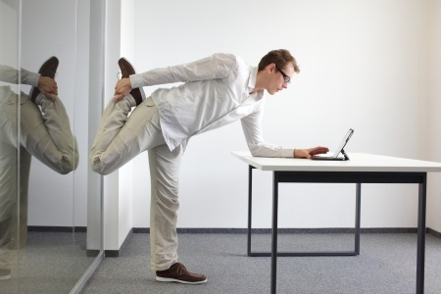
General Rule for Trademarks:
The MORE information a trademark conveys about the associated product or service, the LESS useful & valuable it is as a trademark.

Slide 22

Trademark Ownership & Registration
Trademark rights & ownership are acquired through use of the mark in commerce.
Registration of a trademark is not necessary, but registration provides benefits to the owner.
Benefits include:
  Rights extend nationwide from the filing date of a trademark application, even if use is in a limited region.
  Constructive notice to the public of ownership.
  Legal presumption of ownership of the mark and the exclusive right to use the mark nationwide on or in connection with the goods and/or services listed in the registration.
  Use the U.S. registration as a basis to obtain registration in other countries.
  Right to use the registered trademark symbol “®”.

Slide 23
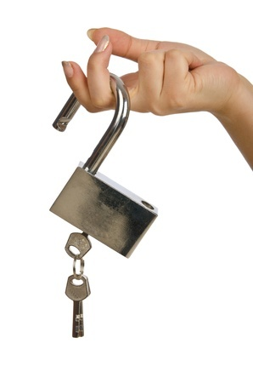
What Can Be Protected by a Copyright?
Original works of authorship fixed in a tangible medium.
  The work to be perceived, reproduced, or otherwise communicated.
Protects the expression of an idea, but not the idea or concept itself.
Copyright generally not available for:
  Words
  Symbols
  Slogans
  Common designs

Slide 24

What Types of Work Receive Copyright Protection?
Copyright protection available for work that contains sufficient originality & expressive elements.
Unlike in patent law, there is no requirement that a copyrightable work be sufficiently distinct from earlier creations.
  Independently created.
  Possess a spark or minimal degree of creativity.

Slide 25

What Types of Work Receive Copyright Protection?
Examples of copyrightable material include musical compositions, sculptures, & motion pictures.
Logos, hangtags, labels, and even packaging that feature artwork or graphic design elements may be copyrightable.
Copyright registration for trademarks that incorporate such artwork or graphic design elements can provide another layer of protection for the mark/logo.

Slide 26
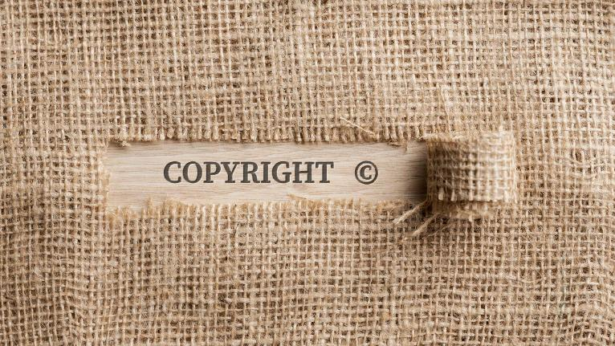
Scope of Copyright Protection
A copyright protects the elements of a work that are original.
Public domain elements can be “selected, coordinated, and arranged in such a way as to render the work original”.

Slide 27

Copyright Ownership
Generally, the creator(s) of the work owns the copyright, except for:
“Work Made for Hire”
  A work prepared by an employee within the scope of his or her employment is owned by the employer.
  Certain statutorily enumerated works specially ordered or commissioned are not owned by the creator, if the parties expressly agree in a signed writing that the work is a work made for hire.
Sale of the entire copyright.

Slide 28
Copyrights: 70 / 95 / 120 Years
Copyright protection (for works created after Jan. 1, 1978):
  Generally 70 years after author’s death.
If a work made for hire:
  95 years from year of first publication or 120 years from year of creation.
Assignment: author retains right to terminate after 35 years (17 U.S.C § 203).
  If less than all rights conveyed, author may be able to exploit work in derivatives.

Slide 29

Copyright Rights & Registration
A copyright gives its owner the exclusive right to:
Reproduce the work.
Prepare derivative works.
Distribute copies of the work.
Perform certain works.
Display certain works.
Copyright registration is not necessary for protection, but registration provides certain benefits to owners.

Slide 30
Why Register a Copyright?
Copyright protection (for works created after January 1, 1978) vests as soon as the copyrightable work is fixed in a tangible medium.
Obtaining a copyright registration enhances this protection.
Evidence of ownership & facts in registration:
  If copyright application is filed within 5 years of publication, registration certificate will be prima facie evidence of the validity of the copyright & of the facts stated in the certificate.
Registration is generally a prerequisite for filing a copyright infringement lawsuit for works of U.S. origin.
Registration prior to infringement of the work, or within 3 months of the work’s publication, entitles the copyright owner to seek statutory damages (in lieu of actual damages and profits) and attorneys’ fees.

Slide 31
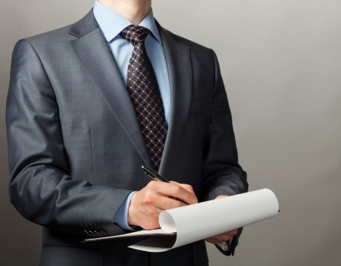
What is a Trade Secret?
A trade secret is any information, including a formula, pattern, compilation, program, device, method, or process:
That derives economic value from not being readily ascertainable.
Is the subject of efforts that are reasonable under the circumstances to maintain its confidentiality.
Example: KFC’s Fried Chicken Recipe.

Slide 32

Trade Secret Requirements & Limitations
To receive trade secret protection, information must be:
  An actual secret.
  Protected by reasonable efforts.
  Valuable as a secret.
Limitations on trade secret protection include:
  Independent discovery.
  Reverse engineering.

Slide 33
Is there a trade secret?
6 factors used in both common law & statutory jurisdictions:
  Extent of the measures used to protect the secrecy of the information.
  Commercial value of the information to the business and to its competitors
  Extent to which those in the company knew about it.
  Extent to which those outside the company knew about it.
  Ease/difficulty with which it was developed.
  6. Ease/difficulty with which it could be duplicated by another.

Slide 34

Trade Secret Misappropriation
Trade secret misappropriation occurs when there is a wrongful use, disclosure, or acquisition of the trade secret by “improper means.”
Trade secret misappropriation typically occurs in the context of employer-employee relationships, but may also occur when any person or thing is given access to protectable information.

Slide 35
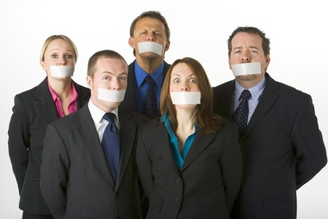
Protecting Trade Secrets
No need to file / register.
But, you must be proactive:
  Stamp “confidential” on appropriate files.
  Instruct employees to not disclose secrets.
  Install security systems.
  Use non-disclosure & confidentiality agreements.
Duration: lasts until it becomes public knowledge.

Slide 36
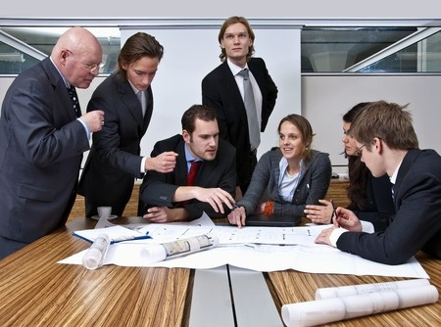
Best Practices for Protecting IP
Develop an IP company policy & portfolio.
Obtain non-disclosure agreements & assignment agreements.
Mark protected products & goods.
Weigh costs and benefits of registering copyrights & trademarks, as well as applying for patents.
Weigh costs & benefits between potential patent & trade secret protection.
Enforce rights against infringers.

Slide 37
Best Practices for Avoiding Infringement
Perform research on existing IP.
1
Question & understand how employees obtain and develop ideas, marks, or publications.
2
Understand the marketplace prior to launching new products and services.
3
Engage services to monitor new IP filings and perform infringement analysis.
4

Slide 38
3/10/26

Slide 40
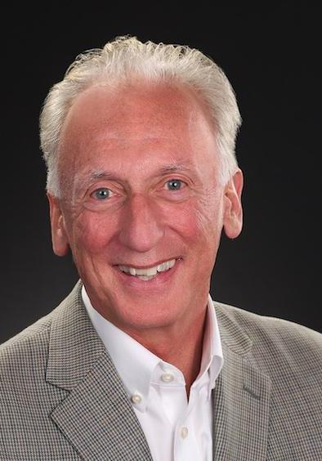
Allan Grafman - allangrafman@allmediaventures.com
Allan Grafman is an investment banker at Oberon Securities, with over 30 years of experience raising capital and leading M&A transactions for media, licensing, and content technology companies. He has closed numerous transactions in all sectors of businesses driven by ownership and monetization of intellectual property.
Recently, Allan has served as CEO of IDW Media Holdings (NYSE) after serving for many years as Chairman of the Audit Committee. As CEO of All Media Ventures, he has been active in media advisory and served as a board director for both public and private companies. Allan is an expert in both media and technology, with a focus on intellectual property (IP) for consumer-facing and B2B companies in licensing, entertainment.
He has served as a fiduciary Board Director of over 12 companies. Other roles include Operating Partner at a private equity fund and CEO of a VC backed tech company. Allan’s early career highlights include: President of Archie Comics; EVP & CFO of Hallmark Entertainment; VP & MD at Tribune Company; VP & GM at CCB/ABC/Disney; and Announcer and Salesman at KSHE Radio.
Read more

Slide 41
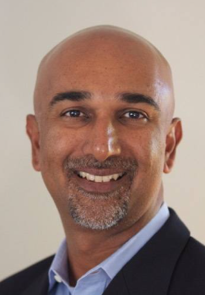
Sanjay Prasad - sanjay@prasadip.com
Sanjay has practiced at the forefront of technology and intellectual property for over twenty years. He is experienced in all business and legal aspects of intellectual property from developing IP strategy for senior management to execution of the strategy, including patent portfolio development, deal development and negotiation and monetization.
Sanjay has practiced in law firms in Boston and Silicon Valley, served as chief patent counsel to Oracle Corporation, headed up the India office of IPVALUE Management and served in several senior roles at Intellectual Ventures. Sanjay has been repeatedly recognized by Intellectual Asset Management Magazine as one of the world’s leading IP strategists. He has testified before a U.S. Congressional Subcommittee on hearings that led to passage of §19 of The America Invents Act.
Sanjay is an Associate Professor of Law in the Intellectual Property Law Program at the Sandra Day O’Connor College of Law at Arizona State University.
Read more

Slide 42
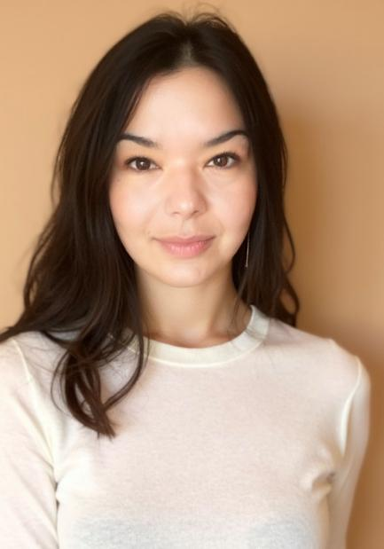
Barine Majewska - b.majewska@vicentellp.com
Barine Majewska is counsel in Vicente LLP's Denver office, where she is a leading member of the firm's Psychedelics and Emerging Therapies Practice Group. She became an attorney because she loved the logical reasoning skills required by law, and grew to enjoy applying those skills to help people and companies be successful in business. After graduating from the University of Virginia School of Law, she joined the corporate department at Cooley LLP, where she worked with technology and startup companies doing venture capital, M&A, and technology licensing work.
Later in her legal career, her long-standing respect for psychedelics and plant medicine work led her to a fantastic opportunity to intern in psilocybin studies at the Johns Hopkins School of Medicine, where her firsthand experience working as both a research assistant and guide in psilocybin sessions gave her clear insights into the potency, benefits, and pitfalls of psychedelic work.
In 2016, Barine returned to law and joined Vicente LLP. She applies Vicente LLP’s pioneering spirit in the cannabis industry to fostering the effective, safe and legal use of psilocybin, ketamine, MDMA and other entheogens.
Read more

